Slide 1
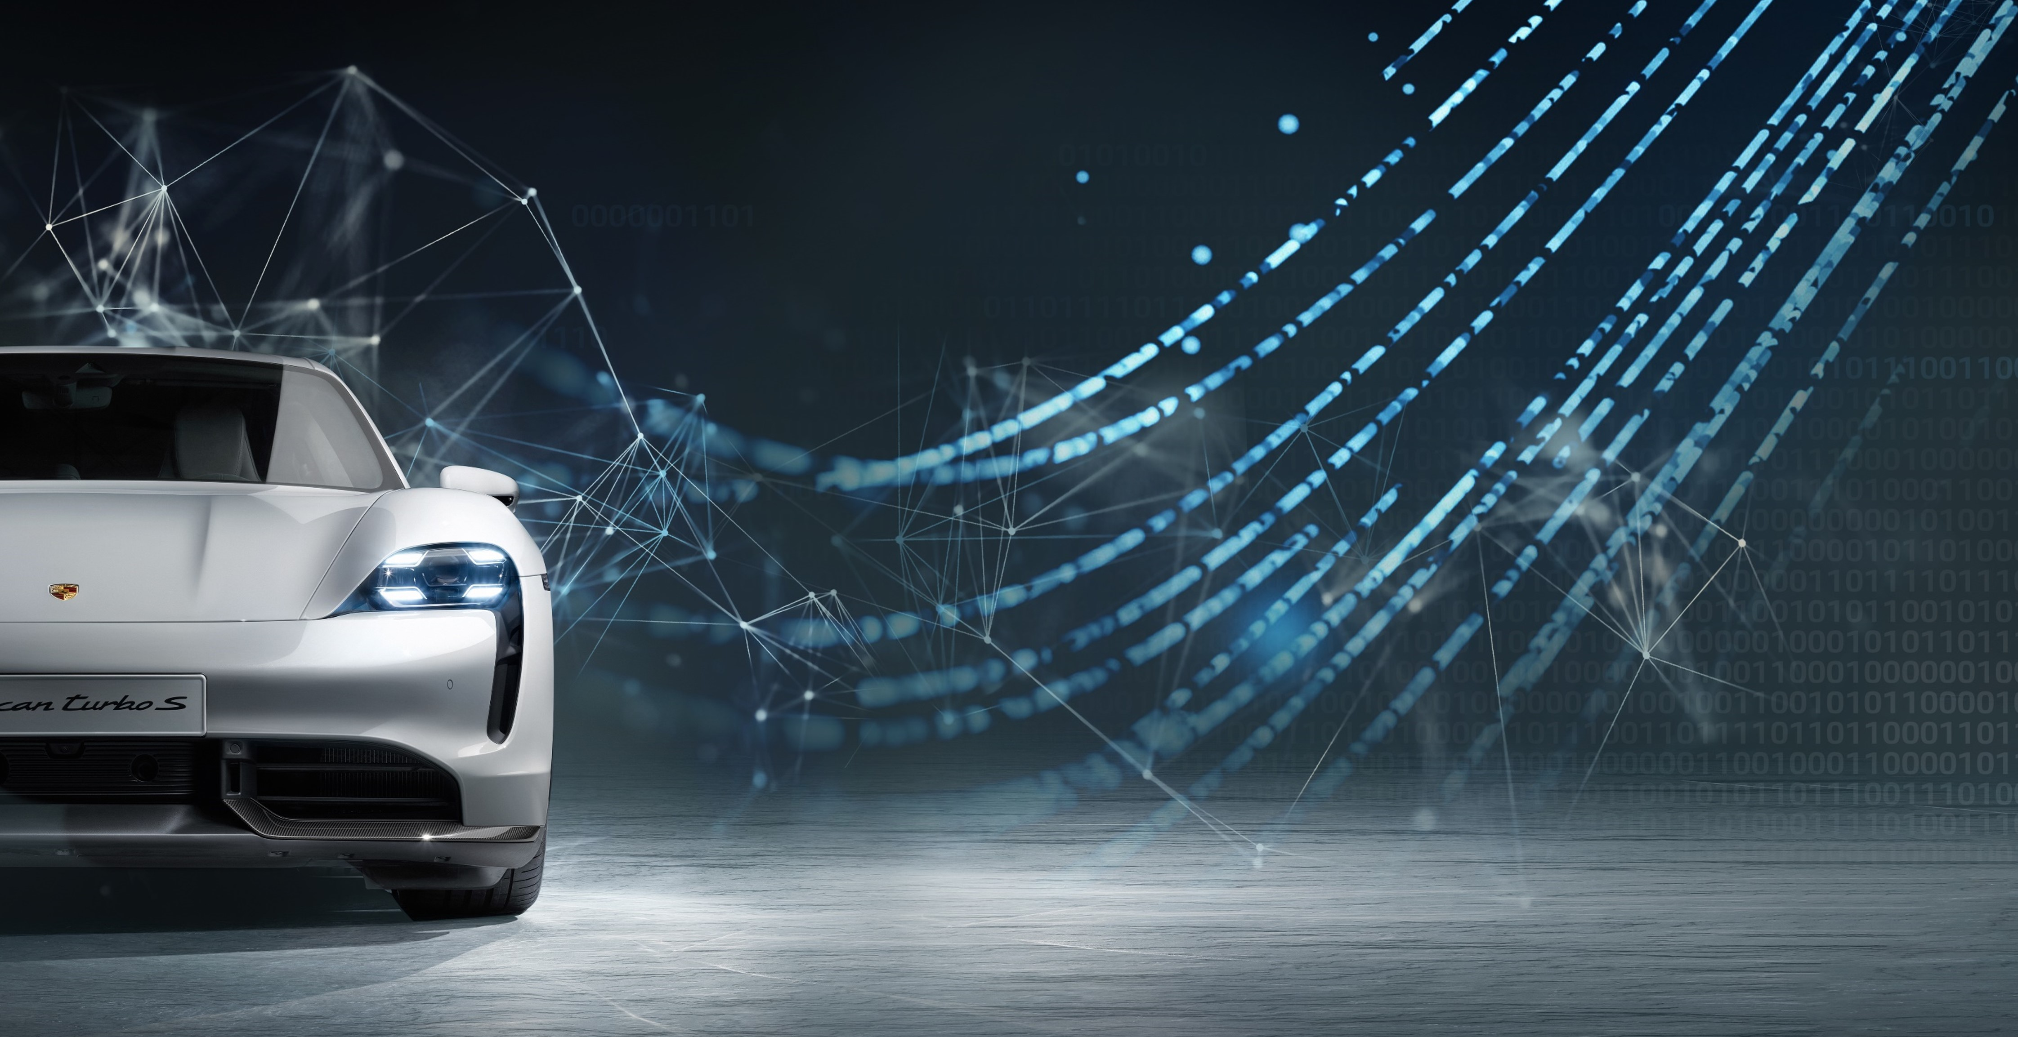
Porsche Engineering
Student Contest 2023 Technical introduction

Slide 2
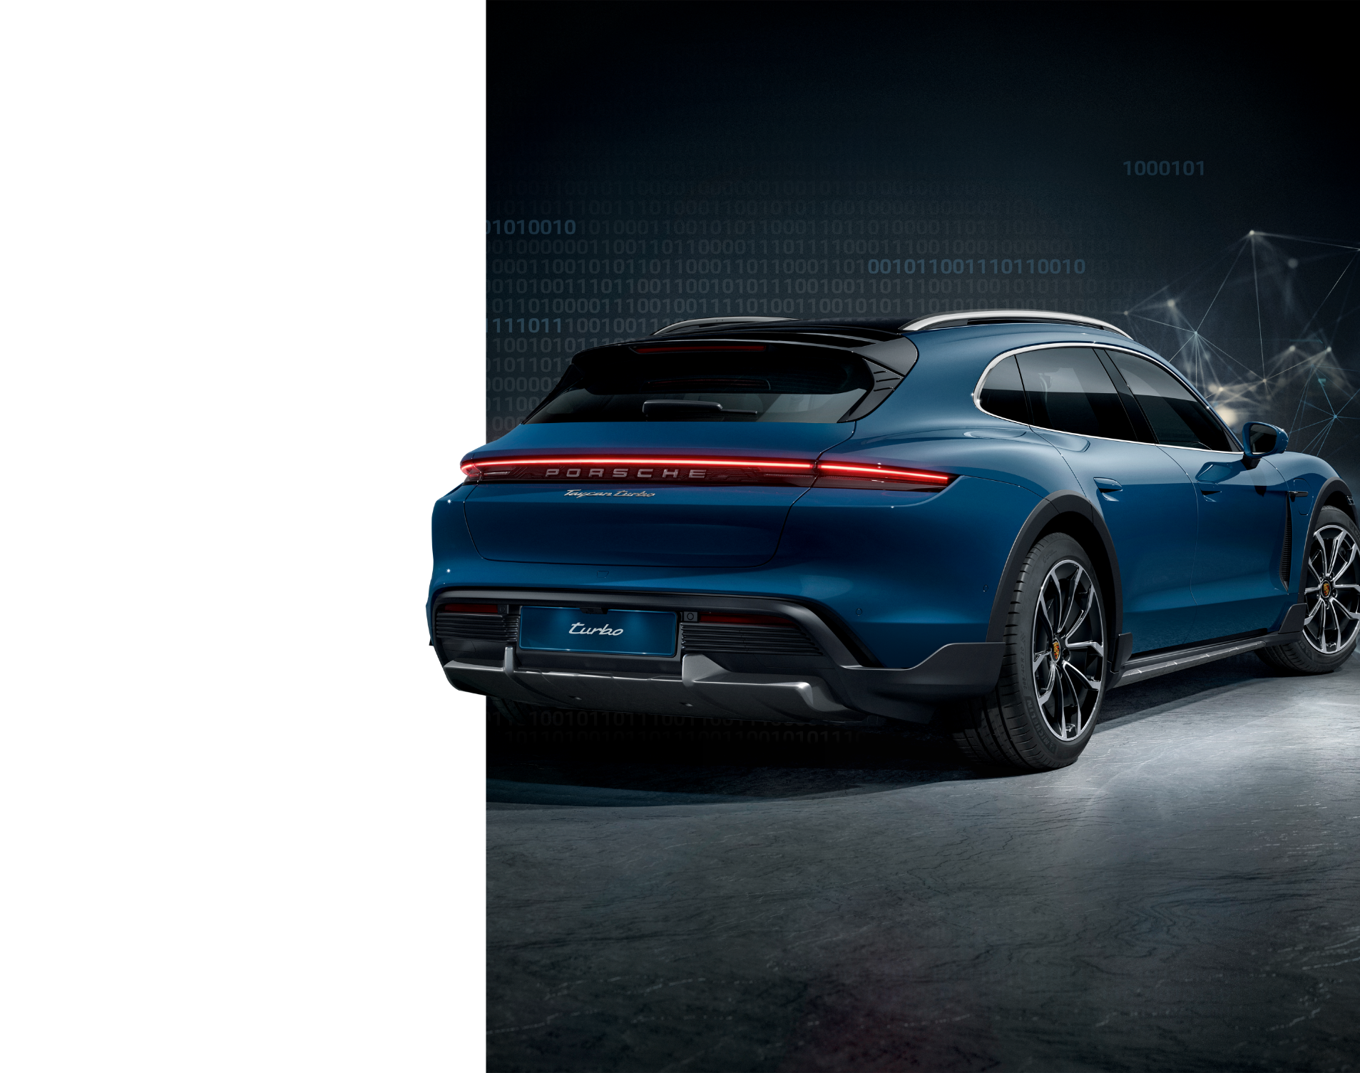
Computer and Requirements
Computer with pre-loaded essential software necessary for developing the solution will be provided.
Feel free to install any additional tools you might require.
Requirements for computers:
Python 3.7.x
OpenCV
NumPy
PyGame
Carla 0.9.14
The portable version enables you to log in to the Carla server running on a different machine.
If you wish to run the competition map and utilize our car model on your PC, you will need to install the Carla server.

Slide 3
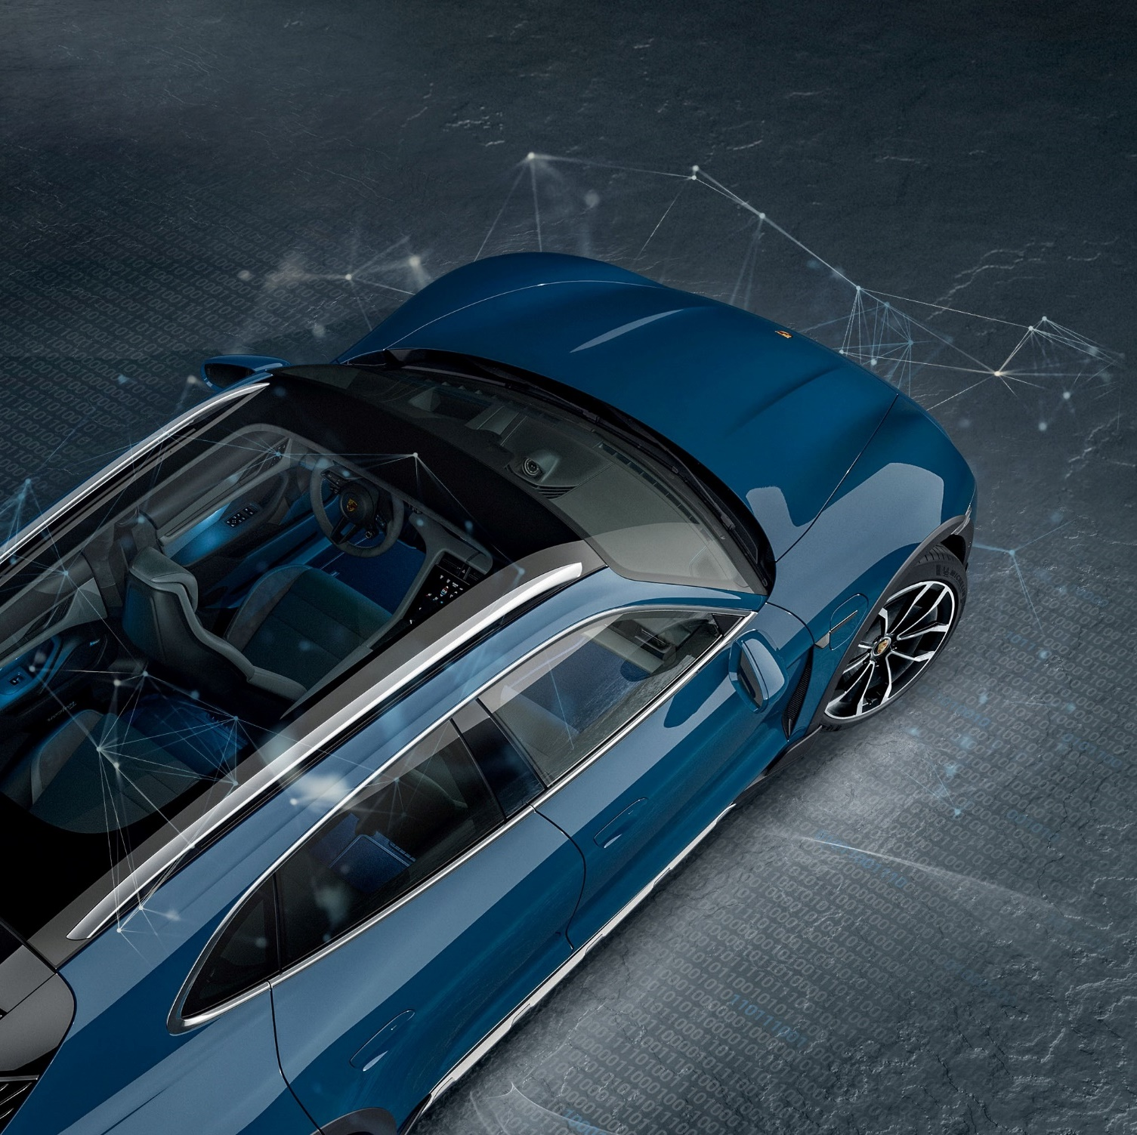
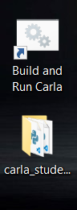
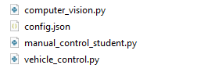
Where to start?
Carla
Local Carla server
Start it to test your solution locally
Student
Client control scripts, serving as the foundation for your autonomous driving script

Slide 4
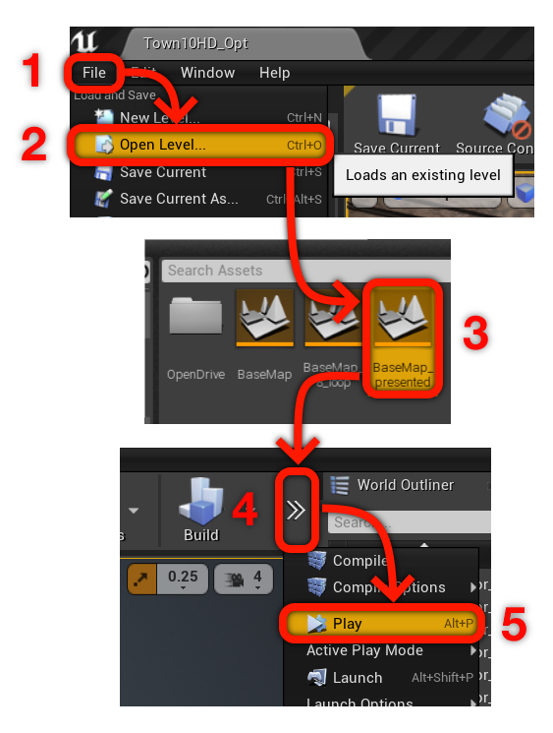
Local Carla Server
After running the 'Build and Run Carla.bat' file, the environment will initiate.
Your next step is to select the appropriate map and start the simulation.
Refer to the screenshots for guidance.
Open the Carla window and click on the 'File' option in the top left corner.
Select 'Open Level...' from the dropdown menu.
Choose 'BaseMap_presented' from the map list. (This map is the one currently running on the server)
After the map loads, click on the '≫' button to reveal more options in the ribbon at the top.
Press the 'Play' button to start the server.

Slide 5
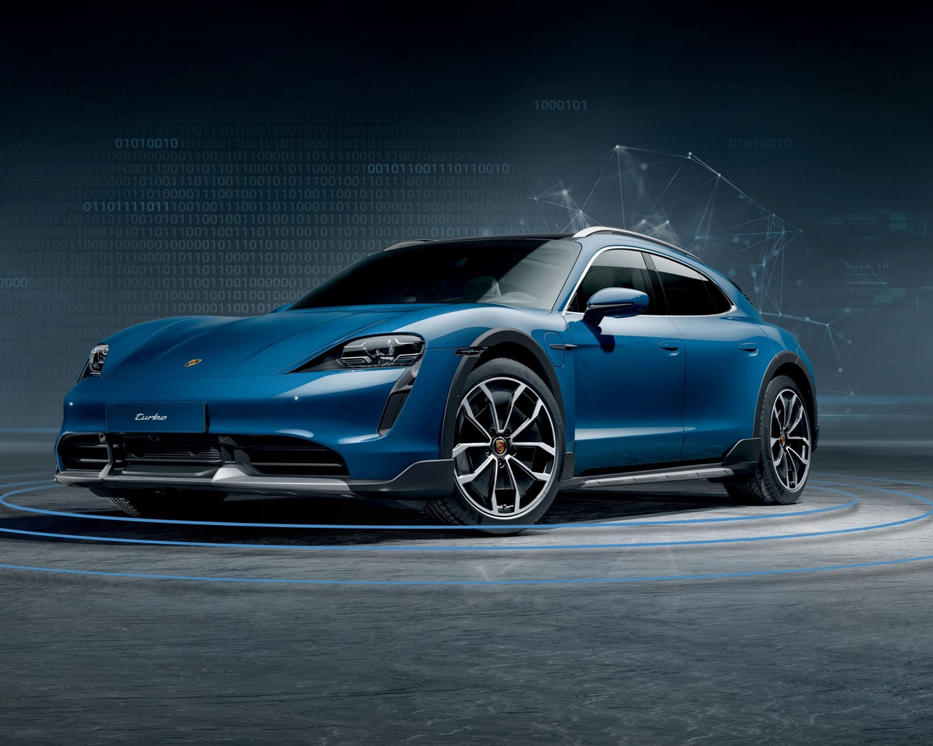
Client Control Scripts
What we have provided
manual_control_student.py
This script, a slightly modified version of 'manual_control.py' provided with Carla, allows you to connect to the server. Execute this script using the command: python manual_control_student.py
computer_vision.py
This file is designed for you to develop computer vision functionality. It processes data and provides outputs that enable 'vehicle_control.py' to steer the car.
vehicle_control.py
This file is meant for utilizing the data supplied by 'computer_vision.py' to control the car effectively.
config.json
This is the configuration file for 'manual_control_student.py,' offering necessary settings for the script.

Slide 6
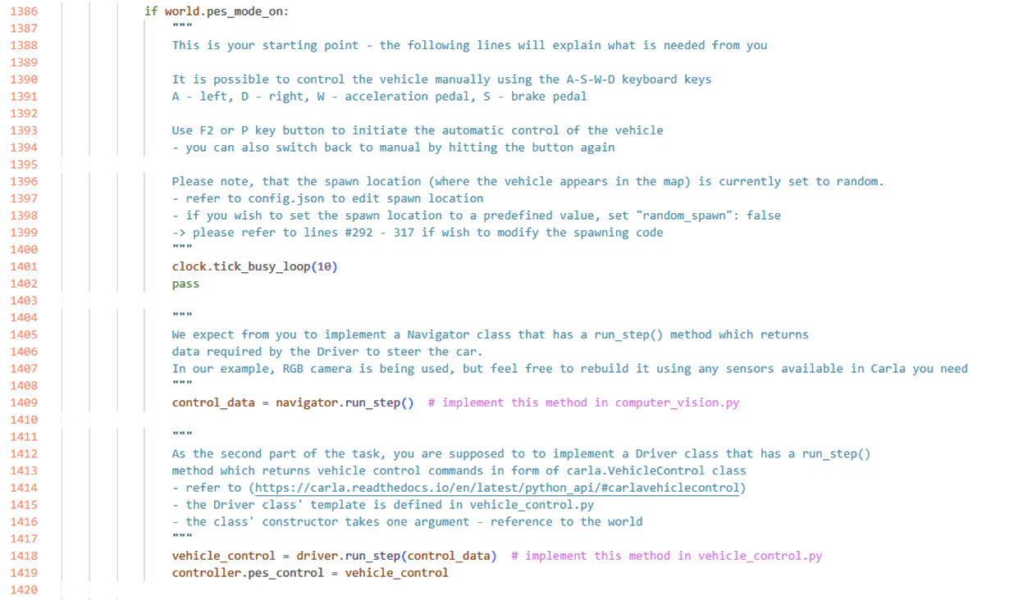
manual_control_student.py
When you press the F2 or P button, this block of code in the game loop is executed.
Before you begin development, be sure to review the comments provided.

Slide 7
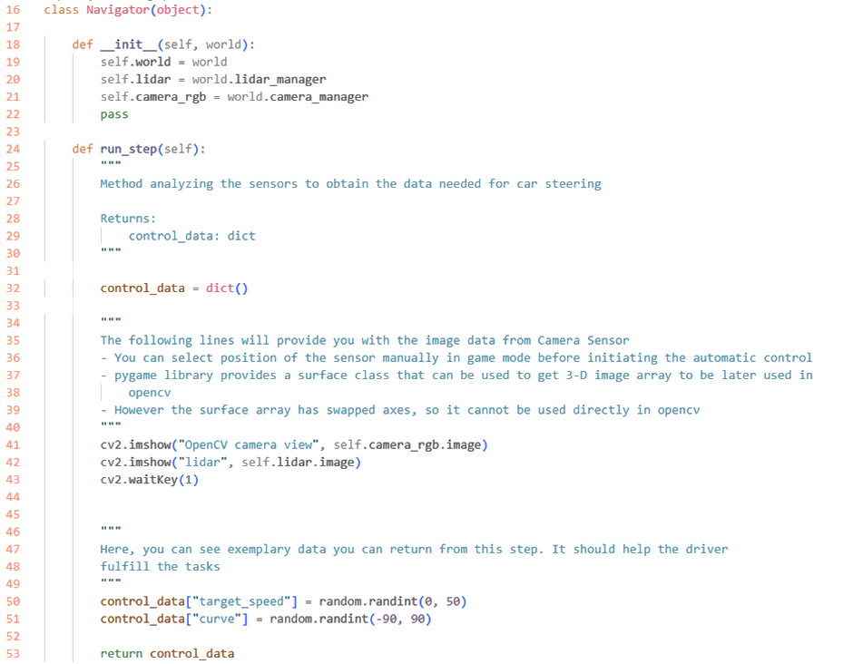
computer_vision.py
This file comprises the definition of the Navigator class.
We recommend utilizing this file for the entire logic behind image recognition. As you may have noticed, we have passed the Lidar and RGB Camera to the main function, providing you a starting point.
We also recommend returning a dictionary containing all the data that will be used later for steering the car.

Slide 8
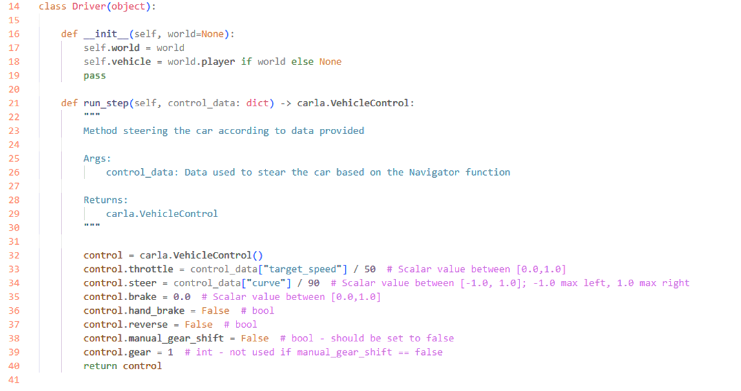
vehicle_control.py
This file is dedicated to car control logic.
Here, you have the freedom to develop any data processing methods that will ultimately result in smooth car steering.

Slide 9
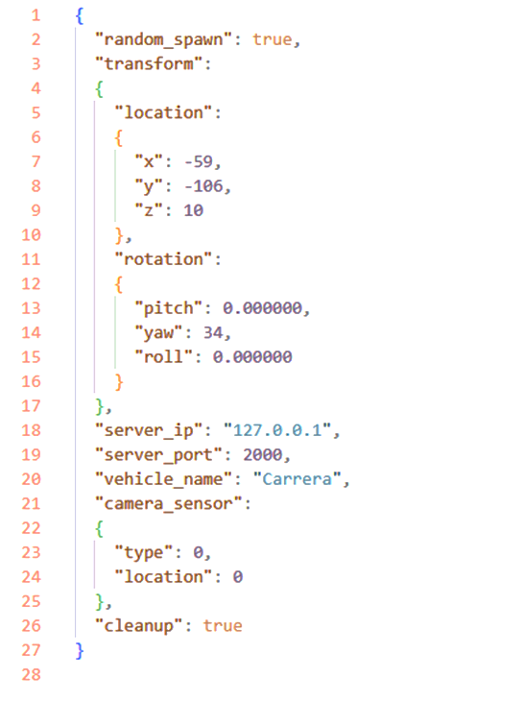
config.json
This serves as the configuration file for 'manual_control_student.py.’
Within this file, you have the ability to define the spawn point of your car, specify the IP address of the server you wish to connect to, set the car’s model name, and determine the location of the camera sensor (which can be later adjusted using the TAB button).

Slide 10
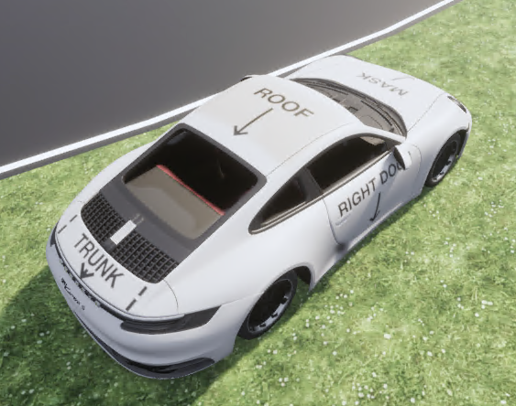
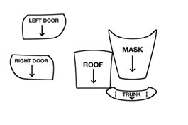
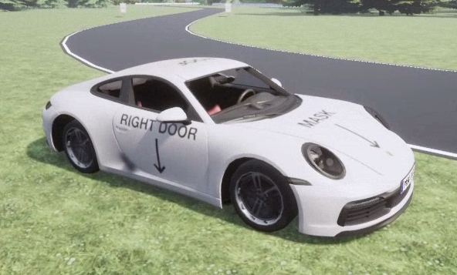
Pimp My Ride
If you're feeling creative, we give you chance to design your own Porsche car. Take a look at C:\appl\carla-git\Unreal\CarlaUE4\Content\Carla\Blueprints\Vehicles\PorscheCarrera_Student\CarDecals.png
Feel free to edit this file as you like. Changes will be automatically applied to the car.

